Slide 1
What is Statistics?
BUSI 2305
Business Statistics

Slide 2

Gooooooooooooals
Understand why we study statistics.
Explain what is meant by descriptive statistics and inferential statistics.
Distinguish between a qualitative variable and a quantitative variable.
Analyze the attributes that make how a variable discrete or continuous.
Distinguish among the nominal, ordinal, interval, and ratio levels of measurement.

Slide 3

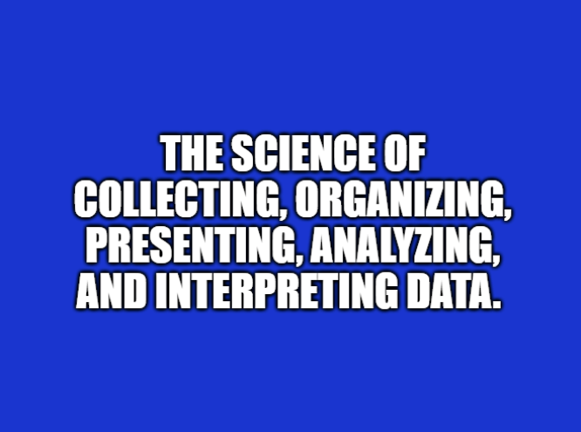

What is statistics?
What is statistics?
100% correct!
Notes:
Guy should have gotten double points for pointing at it too.

Slide 4

… but why?
Statistics enables us to organize, summarize, and present data in an informative or compelling way (Descriptive Statistics).
Statistics also provides support for managerial decision-making, greater accuracy in models/forecasting, and understanding variations in the data (Inferential Statistics).

Slide 5
Where does the data come from?
Population – collection of every possible person, place, thing, or object of interest that is relevant to the statistical analysis being performed.
Sample - smaller portion or subset of that population of interest
We use the sample and the statistical analysis we apply to that sample to infer things about the larger population.
Also, analyzing a sample often beats analyzing the population:
The physical impossibility of checking all items in the population.
The cost of studying all the items in a population.
The sample results are usually adequate.
Contacting the whole population would often be time-consuming.
The destructive nature of certain tests.
Notes:
E.g., employment rate - can’t count everyone that’s unemployed so sample the population and extrapolate. What is the population used to calculate the unemployment rate? Cf., labor market participation rate = 62%... What does that mean for unemployment?

Slide 6

Classifying data – Quantitative variables
VARIABLES are where the values from the data are assigned. They represent the characteristic(s) of interest used in the analysis.
Variables can be QUANTITATIVE, by being a quantifiable value – one that is usually* measured numerically (median income, delivery time, factory output, etc.)...
Notes:
Usually*
Exceptions include some jersey numbers, most state highways, student IDs, the “1%”, Adele album titles, all examples of qualitative (with an ‘L’), numeric data that are not really measured, or that quantify some value, as much as they represent, symbolize, or help to classify the data in some… nominal way.

Slide 7
Classifying data – Qualitative variables
VARIABLES are where the values from the data are assigned. They represent the characteristic(s) of interest used in the analysis.
…or variables can be QUALITATIVE – ones that are used to define an attribute or quality of the subject of the study (usually nonnumeric).
Variable | Value
Area of Expertise | Math
Level of Performance | Competitive
Driving Restriction | Corrective Lenses
Job Title | Quant (Quantitative, Math Specialist)
Notes:
Both? What about payment status (on-time, late, in collections)? Age cohorts (boomers, zoomers, millennials)

Slide 8
Classifying data – Variable Types
Variable Types
Qualitative
Quantitative
Examples:
Employer
Job Title
Highest Degree Obtained
Marital Status
City of Residence
Retirement Plan Preference
Examples:
DOB
Salary
Most Recent PE Score
Accrued PTO
401k Contribution Amount
Tenure with Company
Notes:
A number can still be a qualitative variable. Zip codes, employee IDs, and phone numbers are good example. If variable has a numeric value that comes from a measurement of some kind, that is a good indicator that it is a quantitative variable.

Slide 9

Classifying data – quantitative variable Types
There’s more…
…. we can quantify the quantitative variables…
…. with two classifications: Discrete and Continuous
Notes:
The two types of quantitative variables are discrete variables and continuous variables.

Slide 10

Classifying data - Discrete variables
Discrete – separate, distinct, individual; describes variables that can only assume certain values; can mean there are gaps between values
Discreet – careful, tactful, or subtle to avoid notice
Notes:
Discrete is spelled with the e’s separated from each other.
This kid is trying to be discreet by not creaking on his way up the stairs, so there are discrete places he can step.

Slide 11
Classifying data – Continuous Variables
Continuous variables can be any value within a specified range.
Notes:
Good examples of variables that are ALMOST always continuous are:
size, distance, growth rates, process time, investment yield, etc.

Slide 12
Classifying data – Variable types (ALL)
Variable Types
Qualitative
Quantitative
Discrete
Continuous
Examples:
Name
Employer
Job Title
Marital Status
City of Residence
Examples:
Headcount
Accrued PTO
Financing Term
Fed Funds Rate
Eggs Sold at HEB
Examples:
Delivery Time
Warehouse Size
Motor Temperature
Connection Speed
Cell Tower Height
Notes:
Replicated for referencing while discussing q’s from previous slide

Slide 13
Classifying data - Levels of Measurement
Nominal Level (Categorical) – data that is classified into categories and cannot be arranged in any particular order.
Ordinal Level (Ordered Categories) – data that is ordered but no differences between the values can be determined
Interval Level - numeric data with equal intervals, or that can be differentiated meaningfully by its values. Interval level data has no natural reference point at zero
Ratio Level – interval level data that has a true, absolute zero point of reference
Notes:
to keep the order of the levels straight… NOIR like the wine or film genre

Slide 14
Classifying data - Levels of Measurement II
Nominal Level – think “name”, all qualitative variables assume nominal level data values; e.g., company name, vehicle type, software platform, telephone number, job title*, building number*.
Ordinal Level – data is ordered/ranked, but it can’t provide any further insight; e.g., big/bigger/biggest, first/second/third place, steps 1-9 in a manufacturing process.
Interval Level – values are meaningful relative to each other, but a value of zero is meaningless or nonexistent (remember that there’s no ‘O’ in ‘interval’, so there’s no ‘0’ in interval level data); e.g., dates, the Fahrenheit temperature scale, dress sizes.
Ratio Level – zero is the absolute reference point (The O at the end keeps from confusing with interval data), and the numerical values at the ratio level are assigned from the test, measurement, experiment, or survey**; e.g., median household income, labor force participation rate, stock price.
Notes:
*Discuss: Analyst I, II, etc. bldg number that represents a measurable value (grade level maybe), DJIA stock prices???
** or study or research or whatever method you’re using to collect data, NOT assigned as a ranking or naming convention

Slide 15
Evaluating Data types
Can data be more than one type?
How should salary be classified?
How would you classify a data set that only contained the stock ticker symbols and EOY stock prices of the DJIA component companies?
What about time?
Notes:
Yes – Analyst I/II/III and Sr. Partner/Jr. Partner/Associate are job titles that contain information about skill level, suggests an ordinal system of pay for analysts with such titles
Salary classification: discuss which ways it could be discrete v. continuous, what about a union or government job… what difference would that make?
DJIA - Go through each of the four levels of measurement to ask what level of information is conveyed by the stock prices alone?
Time – talk through ways that it can be classified using each term defined today

Slide 16
Summary chart
Variable Types
Qualitative
Quantitative
Discrete
Continuous
Examples:
Name
Employer
Job Title
Marital Status
City of Residence
Examples:
Headcount
Accrued PTO
Financing Term
Fed Funds Rate
Eggs Sold at HEB
Examples:
Delivery Time
Warehouse Size
Motor Temperature
Connection Speed
Cell Tower Height
Notes:
Replicated for referencing while discussing q’s from previous slide

Slide 17
Before next class
Do the blackboard assignment
Acquire Microsoft Excel
Remember your study cadence
Time requirements for studying this material should be < 30m

