Slide 1
Oh how we’ve regressed
BUSI 2305
Business Statistics

Slide 2

Gooooooooooooals
Explain the purpose of correlation analysis
Interpret the relationship between two variables using the correlation coefficient
Apply regression analysis to estimate the linear relationship between two variables

Slide 3
Definitions
Correlation Analysis A group of techniques to measure the relationship between two variables.
  Study the relationship between two interval- or ratio- scale variables.
  Start with a scatter diagram.
  Graphic tool used to show the relationship between two variables.
  X-axis: The independent variable, used as the predictor.
  Y-axis: The dependent variable, variable that is predicted.

Slide 4
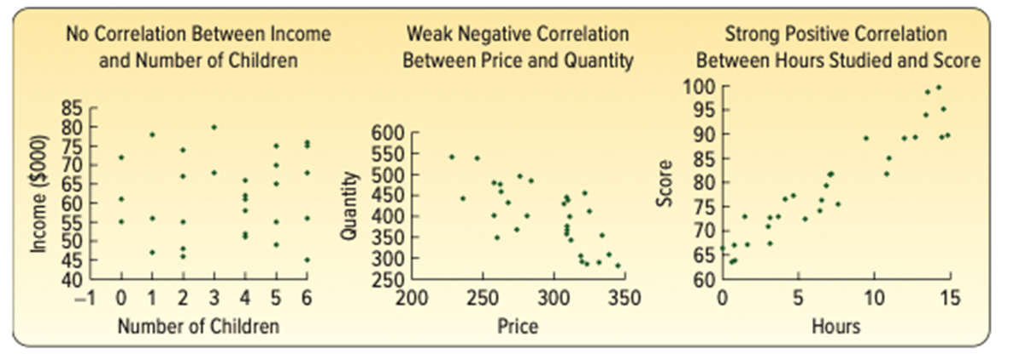
Examples
Notes:
A- no correlation r ~0
B- weak negative correlation r~ -0.6
C- strong positive correlation r~ 0.9

Slide 5
R²
Coefficient of Determination (R²): A Indicates what percentage change in the dependent variable is explained the change in the independent variable
Notes:
If the R squared is 0.9, that means that 90% of any change in y, can be explained by the change in x.
In the previous graph referencing test scores, for an rsq of 0.9, for every 10 points that your test score increased (dependent variable), 9 of those points can be attributed to studying more (independent variable)

Slide 6
R² In practice
0.90+ — strong, beta is reliable for forecasting and decisions
0.70–0.89 — moderate to strong, beta is useful but acknowledge other factors at play
0.50–0.69 — weak to moderate, beta directionally informative but don't lean on it too hard
below 0.50 — too much noise, other variables are doing most of the work
Notes:
This is the official stance of the statistics textbook, but really 0.5 r squared in economics may win you a nobel prize. It depends on what the regression is measuring and how many variables are at work

Slide 7
Beta
β = the factor the determines the rate of change in the dependent variable from the independent variable
Notes:
For a beta of 2, y changes twice as fast as x
For a beta of 0.5, each 1% change in x, causes a 0.5% change in y

Slide 8

Formulas
Correlation Coefficient:
Coefficient of Determination: R²
$$β=r×\frac{σY}{σx}$$
Beta:
Notes:
r in Excel: CORREL()
R² in Excel: RSQ()
Beta in Excel: SLOPE()
correlation coefficient ranges from -1 to +1
An r of -1 means perfect negative (inverse) correlation
An r of +1 means perfect correlation
that is to say for those instances, the data points would all fall perfectly along the same line, rather than scattered around it.
The more scattered, the closer to 0, the correlation coefficient is. The closer to -1 or +1, the closer to the regression line the data falls.

Slide 9
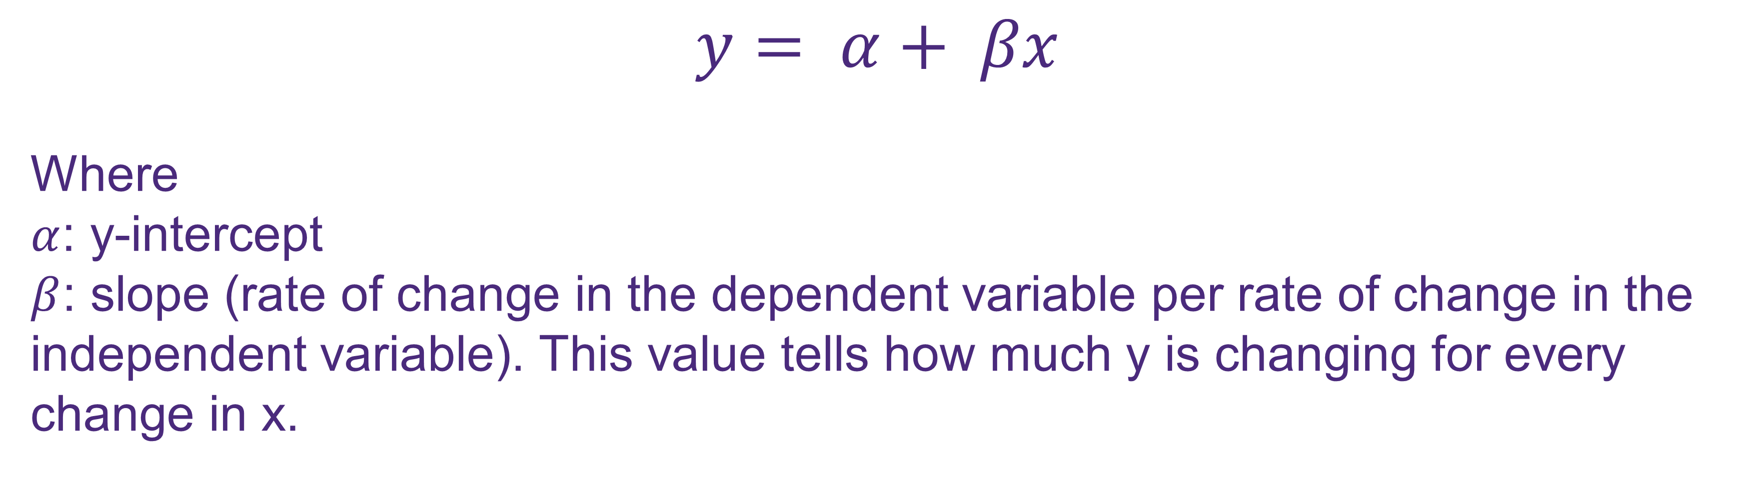
Regression Analysis
Regression analyses help examine the linear relationship between two variables. Enables an estimation of the dependent variable (Y) for a value of the independent variable (X).
$$y= α+ βx$$
Where
$α$: y-intercept
$β$: slope (rate of change in the dependent variable per rate of change in the independent variable). This value tells how much y is changing for every change in x.
Notes:
Alpha in excel is the INTERCEPT() function
Beta is the SLOPE() function

Slide 10
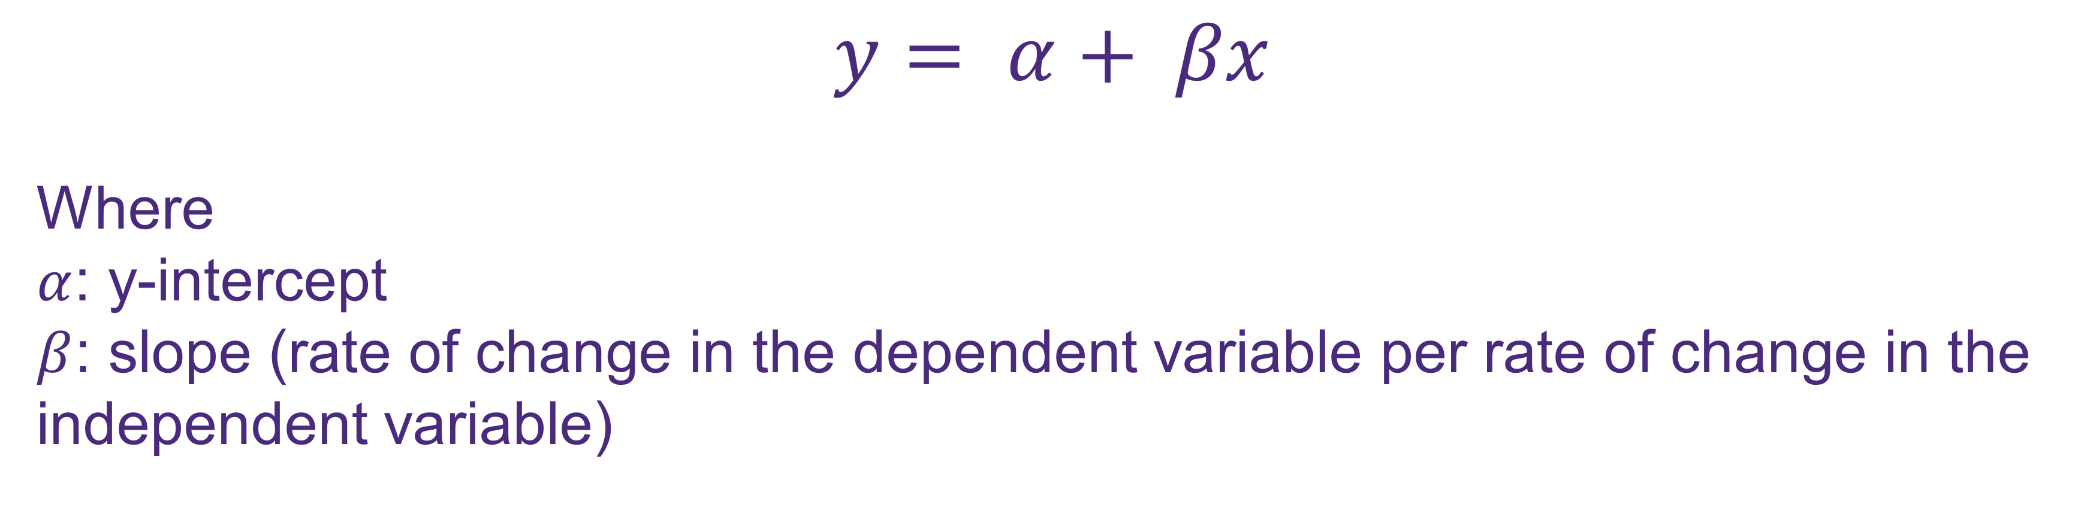
Regression equation
$$y= α+ βx$$
Where
$α$: y-intercept
$β$: slope (rate of change in the dependent variable per rate of change in the independent variable)

Slide 11
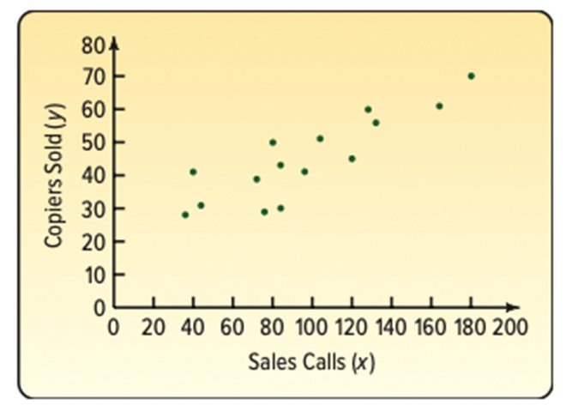
Regression Line
Notes:
Use a scatter diagram to plot the data

Slide 12
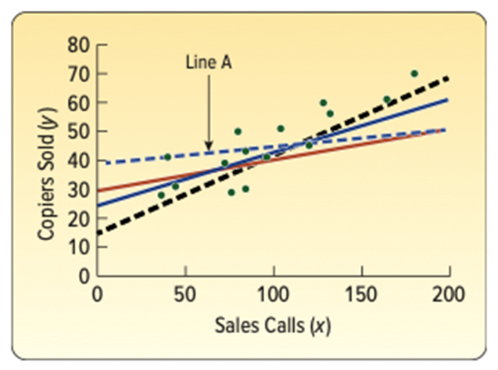
Regression Line
Notes:
The regression (aka ‘best-fit’) line goes through the middle of the data

Slide 13
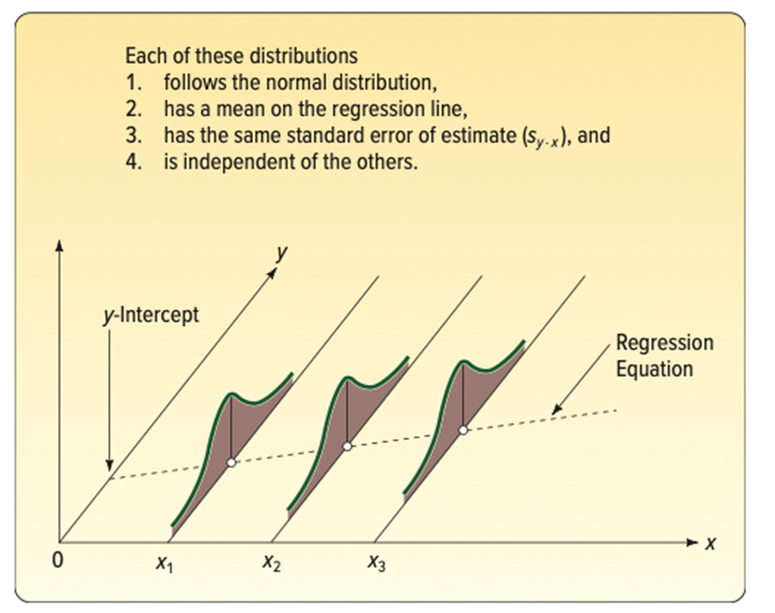
Interval estimates of prediction
Notes:
The regression has confidence internals also

Slide 14
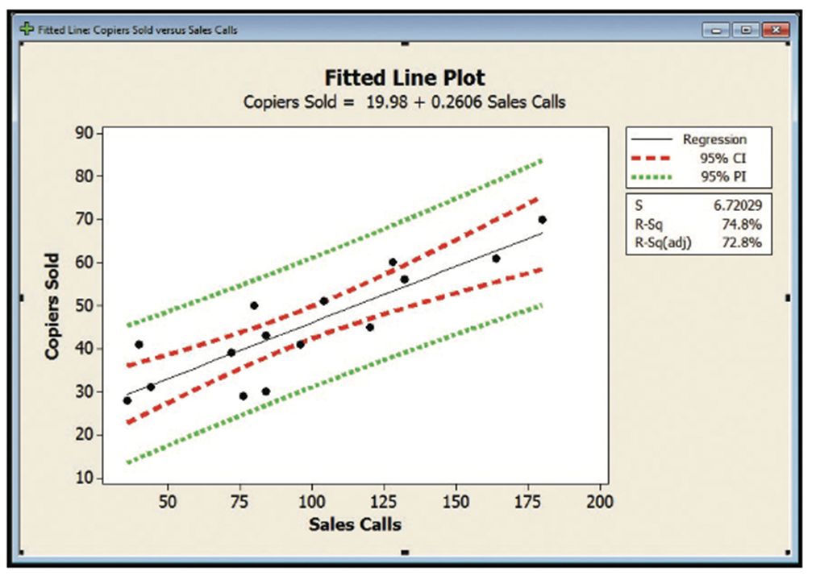
interval estimates of prediction (cont.)

