Slide 1
What are the odds?
BUSI 2305
Business Statistics

Slide 2

Gooooooooooooals
Define probability, experiment, event, and outcome
Understand and explain the differences between classical, empirical, and subjective probability.
Apply rules of addition and multiplication to calculate joint probabilities with and without dependence factors

Slide 3
Definitions
Experiment: a process that leads to the occurrence of one and only one of several possible results
Outcome: a particular result of an experiment
Event: a collection of one or more outcomes of an experiment
Probability: a value between 0 and 1 (inclusive) that represents the likelihood a particular event happens.
Notes:
The sum of all the possible outcomes for a given experiment must sum to 1:
Mutually Exclusive – one event and another can’t occur at the same time
Collectively Exhaustive – At least one of the events must occur when an experiment is conducted

Slide 4

Types of probability
Classical probability assumes that the outcomes of an experiment are equally likely.
Empirical probability is based on observation, counting, and recording experimental outcomes (historical data).
Subjective probability is assigned by an individual based on whatever information is available (forecast).
Notes:
Law of large numbers- over a large number of trials the empirical probability of an event will approach its true probability

Slide 5
Rule of Addition
$$P\left(A or B\right)=P\left(A\right)+P\left(B\right)−P(A and B)$$
The probability of an event happening plus the probability of it not happening sum to one. (mutual exclusivity & collective exhaustion
Joint probability measures the likelihood that two or more events will happen concurrently
A
A & B
B

Slide 6

Rule of Multiplication
$$P\left(A and B\right)=P\left(A\right)P\left(B\right))$$
In statistics, independence means that the outcomes of two events have no impact on each other
Joint probability measures the likelihood that two or more events will happen concurrently
A
A & B
B

Slide 7
Questions?

Slide 8
Combinatorics
where
r = the number selected from a group of
n objects
Notes:
Permutation & Combination formula

Slide 9
What is normal anyway?
BUSI 2305
Business Statistics

Slide 10
Gooooooooooooals
Identify characteristics of a normal distribution
Understand the standard normal distribution
Transform a normal distribution into a standard normal distribution.
Calculate the Z value
Use the Z value to calculate the probability of finding an observation between two values.

Slide 11
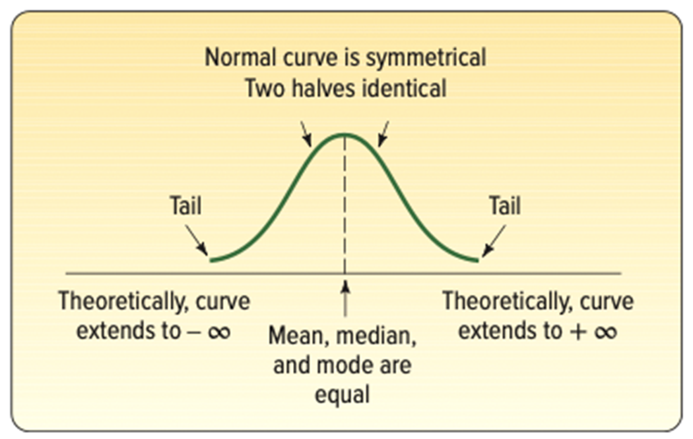
Characteristics of a normal distribution
Bell-shaped.
A single peak at the center of the distribution.
Symmetric.
Asymptotic: The curve approaches but never touches the x-axis.
Completely described by its mean and standard deviation.

Slide 12

Standard normal distribution
Mean of 0
Standard Deviation of 1
Z Value – the distance between a selected value in the normal distribution and the mean divided by the standard deviation
$$z= \frac{x − μ}{σ}$$

Slide 13

Z value
Use the Z value with the NORM.S.DIST() function to determine the probability that an observation will be less than or equal to x.
$$z= \frac{x − μ}{σ}$$
=NORM.S.DIST(arg 1 = Z, arg 2 = TRUE)
Notes:
The ‘NORM function returns the probability the an observation is less than or equal to the value in question

Slide 14
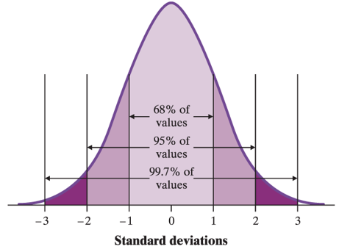
Empirical Rule
For a normal distribution:
68% of observations fall within +/- one standard deviation (1σ) of the mean
95% of observations fall within two standard deviations (2σ) of the mean
99.7% of observations fall within three standard deviations (3σ) of the mean
Notes:
Normal distribution is symmetrical, bell-shaped, and asymptotic.
Asymptotic means that the curve approaches, but never actually reaches zero.

