Slide 1
Beating the spread
BUSI 2305
Business Statistics

Slide 2

Gooooooooooooals
Understand and describe dispersion measures and why they are important in statistics
Define and differentiate measures of dispersion. Explain what these measures reveal about the data.
  Range
  Percentiles
  Variance
  Standard Deviation
Construct and interpret a box plot
Explain skewness, k, and its impact on the data, as well as demonstrate how to quantify it.

Slide 3

Dispersion
Measures of central tendency only describe the center of the data. To get a better sense of how spread out the data is, we use measures of dispersion.
Notes:
Measures of dispersion tell us how spread out the values are that we’re interested in.
Range, Variance, Standard Deviation are calculations that quantify that attribute of the data.

Slide 4
Range
Range = Largest value - Smallest Value
Notes:
Business intelligence (BI) is an umbrella term for the strategies, technologies, and processes—such as data mining, reporting, and predictive analytics—used by organizations to analyze raw data and transform it into actionable insights. BI drives informed strategic and tactical decision-making, helping to identify market trends, optimize performance, and increase efficiency.
It’s the kind of stuff we’re learning about in this class

Slide 5
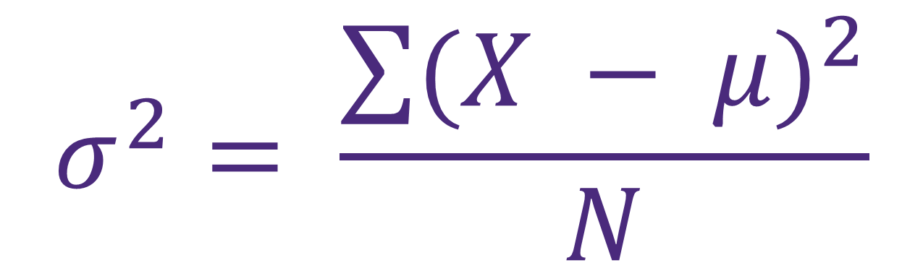

Population Variance & Standard deviation
Population Variance
$$σ^{2}= \frac{\sum{{(X − μ)}^{2}}}{N}$$
Population Standard Deviation
$$σ= \sqrt{\frac{\sum{{(X − μ)}^{2}}}{N}}$$

Slide 6
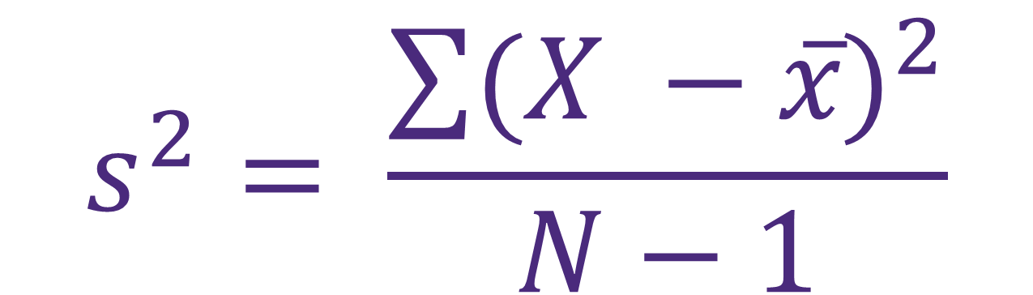

Sample Variance & Standard deviation
Sample Variance
$$s^{2}= \frac{\sum{{(X −x̅)}^{2}}}{N−1}$$
Sample Standard Deviation
$$s= \sqrt{\frac{\sum{{(X −x̅)}^{2}}}{N−1}}$$

Slide 7
Variance & Standard Deviation (EXCel)
=VAR.P()
=STDEV.P()
Population Variance
Population Standard Deviation
=VAR.S()
=STDEV.S()
Sample Variance
Sample Standard Deviation
Notes:
The values you are using to calculate variance/sd go inside the parentheses.
E.g., If your sample data was in column A, and you needed the variance, you’d type
=VAR.S(A:A)
If your population data was located in cells A1 – A100, and you needed the standard deviation you’d type
=STDEV.P(A1:A100)

Slide 8
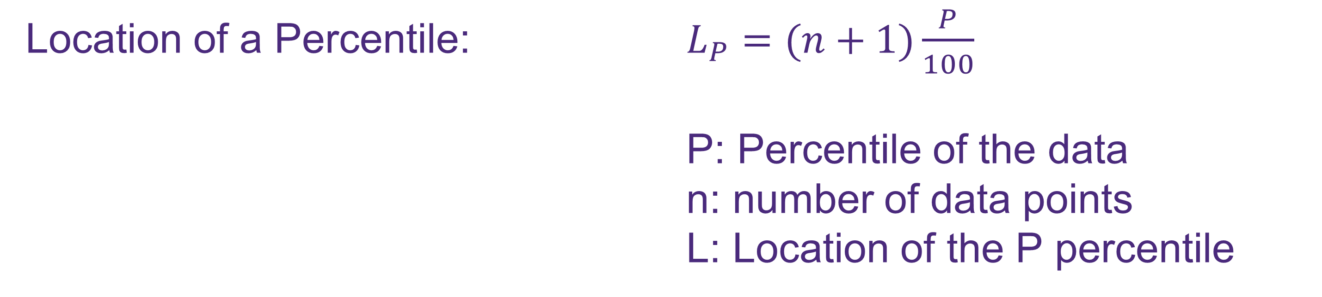
Percentiles
One way to describe the spread of data is to calculate the location of a particular percentile that divides the data set:
Location of a Percentile: $L_{P}=(n+1)\frac{P}{100}$
P: Percentile of the data
n: number of data points
L: Location of the P percentile
Notes:
While the previous three measures of dispersion help quantify that metric, percentiles help define dispersion, but as a measure of location. Percentiles aren’t measuring dispersion directly, they convey information about where certain data points lie that implies dispersion.
What level of measurement would percentiles be?
Quartile= 25% of the points in the dataset
Decile= 10% of the points in the dataset
Percentile = 1% of the dataset
If you have a sample of 400 data points, each quartile will have 100 data points, each decile will have 40 data points and each percentile will have 4 data points.

Slide 9
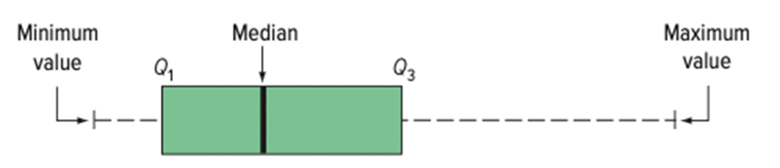
Box Plot
A Box Plot shows the general shape of a variable’s distribution based on five descriptive statistics: the maximum and minimum values, the first and third quartiles, and the median.

Slide 10
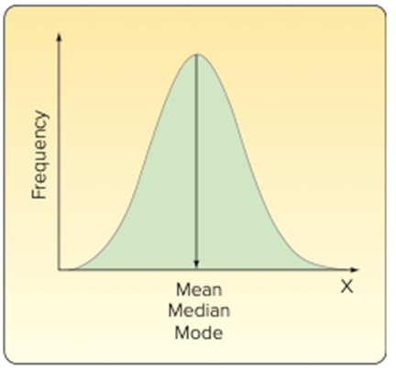
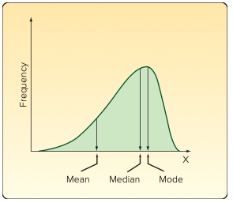
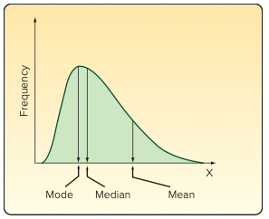
What mean/median/mode say about skewness
Zero Skewness
Negative Skewness
Positive Skewness
Pearson’s Coefficient of Skewness: $sk= \frac{3\left(μ −Median\right)}{σ}$

Slide 11
Questions?

