Slide 1
Just an average statistics lesson
(if you know what I mean)
BUSI 2305
Business Statistics

Slide 2

Gooooooooooooals
Define and differentiate measures of central tendency. Explain what these measures reveal about the data.
  Arithmetic Mean
  Median
  Mode
  Geometric Mean
  Weighted Average

Slide 3
Measures of central tendency
Measures of Central Tendency* attempt to quantify the ‘center’ of the data.
  Arithmetic Mean
  Median
  Mode
  Geometric Mean
  Weighted Mean
<<<-------- | These three work well together. Aside from the information each one reveals individually, their relationship with each other yields additional information when analyzed properly.
Notes:
* Measure of Central Tendency is also referred to as measure of location or measure of position <<< These are rarely used, know what they refer to, but Central Tendency is more accurate

Slide 4
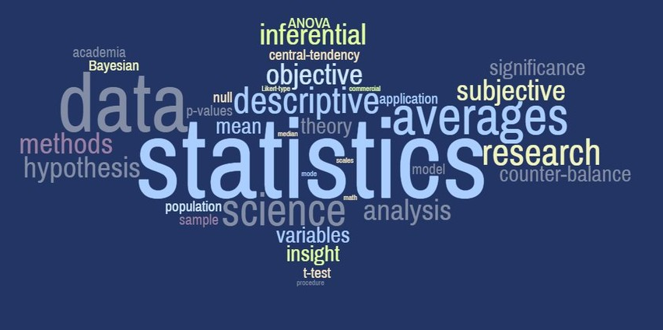
Some Antics related to semantics
This is Business Statistics, so we’ll be using the same terminology as the business community.
Know the technical terms so you know what they mean; however, a key part of presenting a coherent statistical analysis is communicating information in a clear way. Your results will be more compelling and useful if your stakeholders can assimilate the information and make decisions easily and quickly.

Slide 5
Nuances of the incongruences
Statistics Jargon | Business World Corollary
Measure of Central Tendency¹ | Average
Mean (aka Arithmetic Mean) | Average
Geometric Mean, GM | ‘Annualized²___’
Weighted mean | Weighted average, Expectation value, ‘Risk-adjusted ___’
Median | Median
Mode, Modal value | Most frequent occurrence
Variance | Try to avoid using³
Notes:
1- Or Measure of Location, or Measure of Position
2- We will use ‘Geometric Mean’, or ‘GM’ when referring to this operation in class, but when we start to apply it to business problems, we’ll use the variable itself and include “annualized”, i.e., annualized return on investment, annualized growth rate, annualized inflation (%), etc.
3- Avoid using the word variance at all, when someone in finance asks for a variance analysis, you won’t be calculating variance as we define it here. A variance analysis reports (1) the difference between the Actual numbers booked by accounting & the Budget projections, or (2) the Actuals vs. the Forecast

Slide 6
Use Cases for Geometric Mean
  To calculate the average value of the data, first use the data type to determine which formula to use
  Variables dealing with rates of change, or Growth: use Geometric Mean
    Pay Raises ➔ (Income Growth : Geometric)
    Inflation ➔ (Growth in cost of living : Geometric)
    Investment Return ➔ (Growth of investment principal : Geometric)
    Population Growth ➔ Growth : GEOMETRIC!
  Other indicators to calculate the average using the Geometric Mean formula:
  YoY Annualized
  MoM Return/yield
  % Change Compound Interest*
  If you see these terms/phrases, the geometric mean will likely help you in your analysis.
Notes:
YoY = Year over Year, refers to the change from one year to the next
MoM = Month over Month…
* Compound interest is when the interest from one period accrues on the interest received from the previous period.
E.g., You have an interest-bearing account earning 10% which applies to last year’s balance of $1,000 giving you a total of $1,100 ($1,000 principal + $100 interest)
This year the 10% applies to the entire $1,100-> 10% on the initial $1,000 and 10% on the $100 from last year. Now you have $1,210 ($1,000 principal + $100 interest from this year + $100 interest from last year + $10 [last year’s ($100) interest yielded 10% of its own this year]

Slide 7
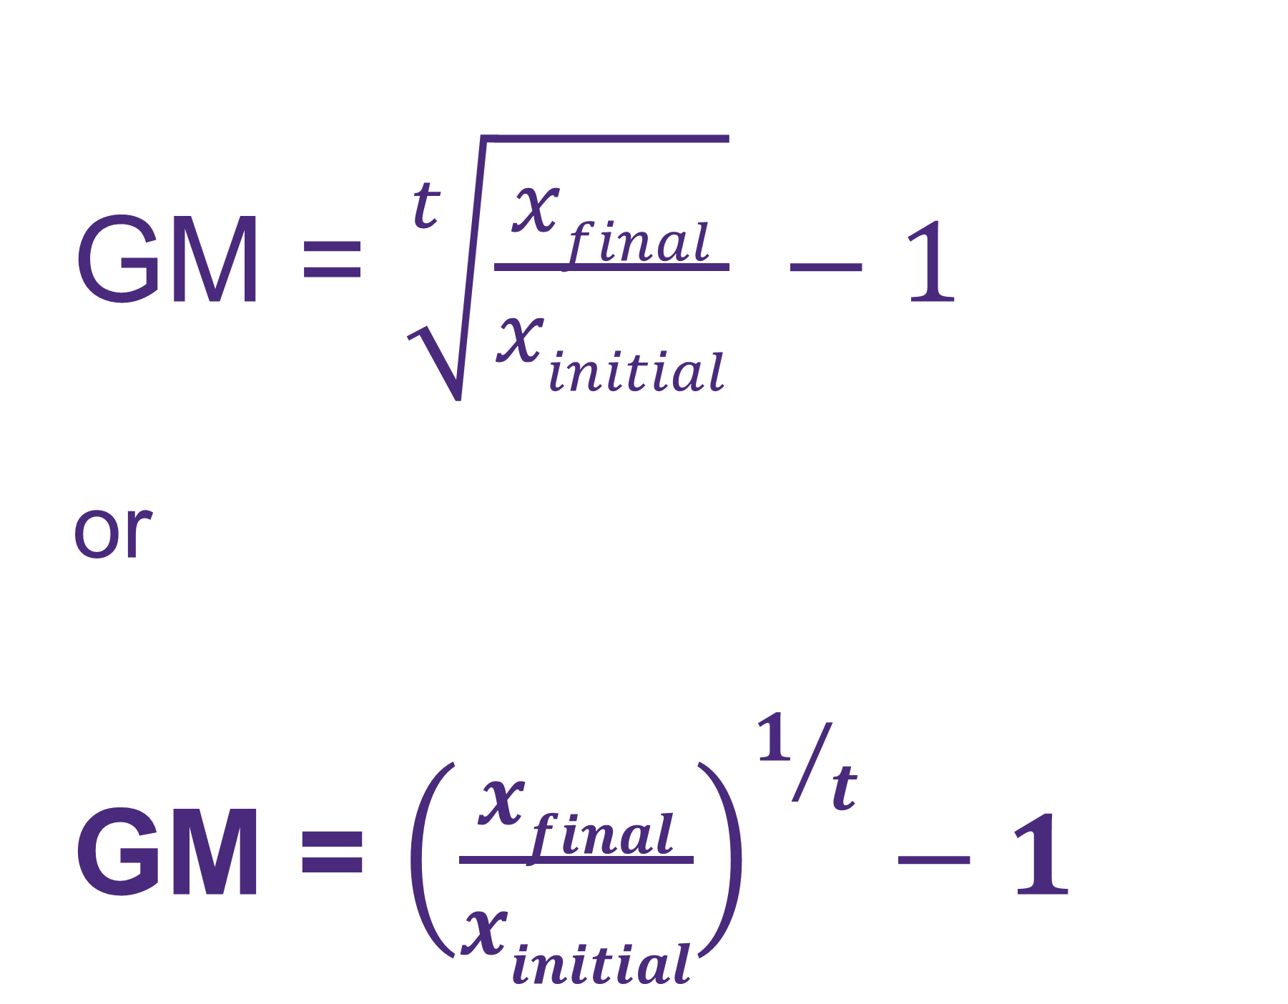
Geometric mean
Since Geometric Mean (GM) is used to calculate annualized growth metrics, the formula is:
GM = $\sqrt[t]{\frac{xfinal}{xinitial}} −1$
or
GM = ${\left(\frac{xfinal}{xinitial}\right)}^{1/t}−1$
x_{final}: final value
x_{initial}: initial value
t: number of years
Notes:
Example in excel

Slide 8
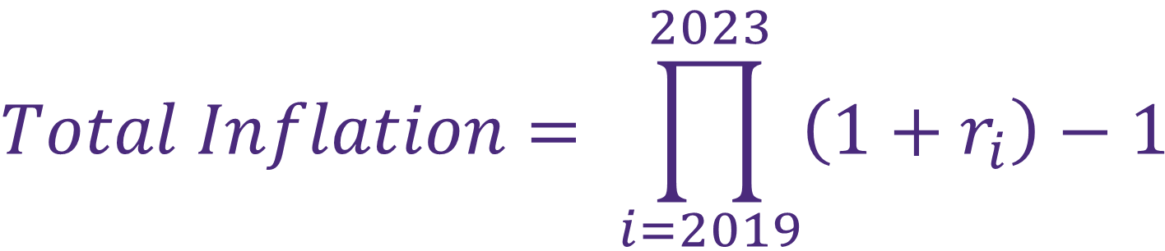
Inflation (total)
Calculate total and annualized inflation for the periods shown here:
Year | Inflation Rate
2023 | 2.9%
2022 | 4.1%
2021 | 8.0%
2020 | 4.7%
2019 | 1.2%
$$Total Inflation= \prod_{i=2019}^{2023}{\left(1+r_{i}\right)−1}$$
r: inflation rate
i: year
= (1 + 1.2%) x (1 + 4.7%) x (1 + 8.0%) x (1 + 4.1%) x (1 + 2.9%) – 1
= 22.7%
Notes:
Π: pi = product

Slide 9
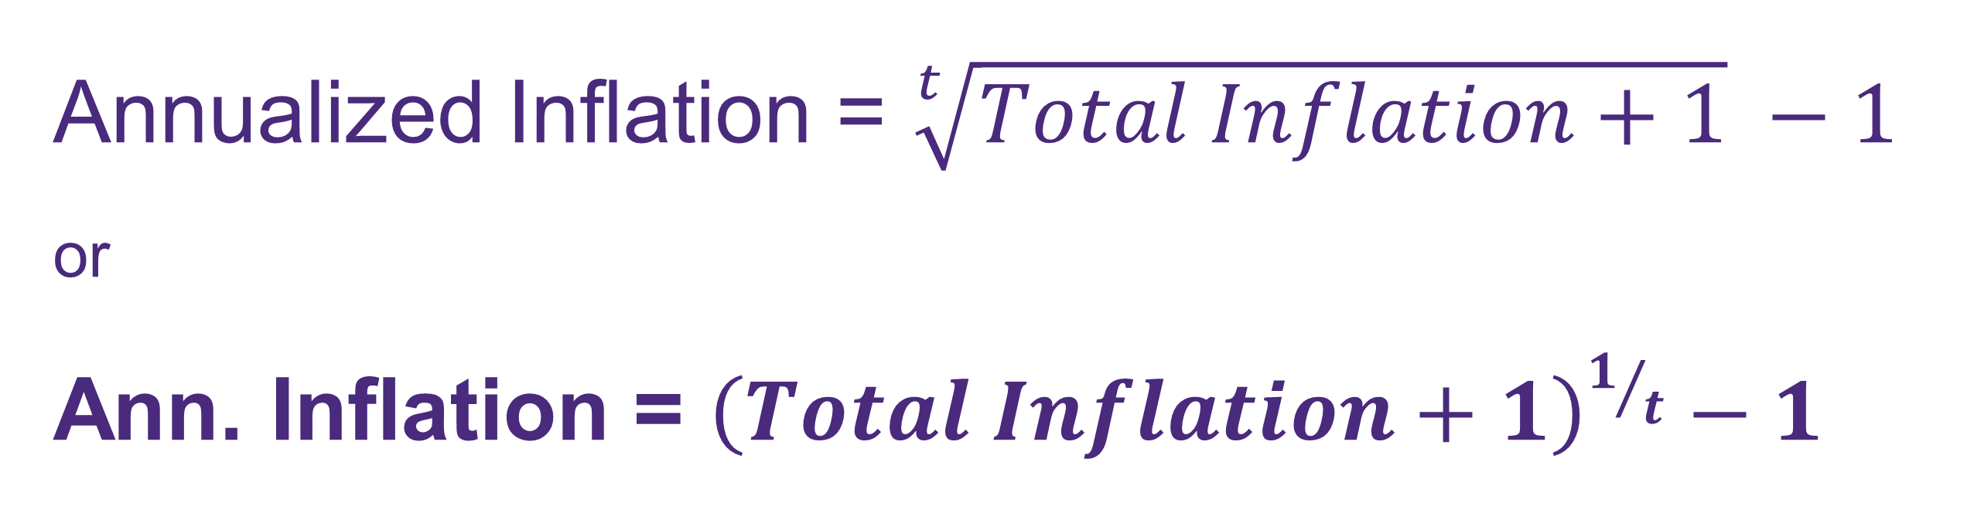

Inflation (Annualized)
Calculate total and annualized inflation for the periods shown here:
Year | Inflation Rate
2023 | 2.9%
2022 | 4.1%
2021 | 8.0%
2020 | 4.7%
2019 | 1.2%
Annualized Inflation = $\sqrt[t]{Total Inflation+1} −1$
or
Ann. Inflation = ${\left(Total Inflation+1\right)}^{1/t}−1$
$${=\left(1+22.7\%\right)}^{1/5}−1$$
$$=4.2\%$$
Notes:
See excel for calculations
*** Don’t use the geometric mean function in Excel! ***

Slide 10
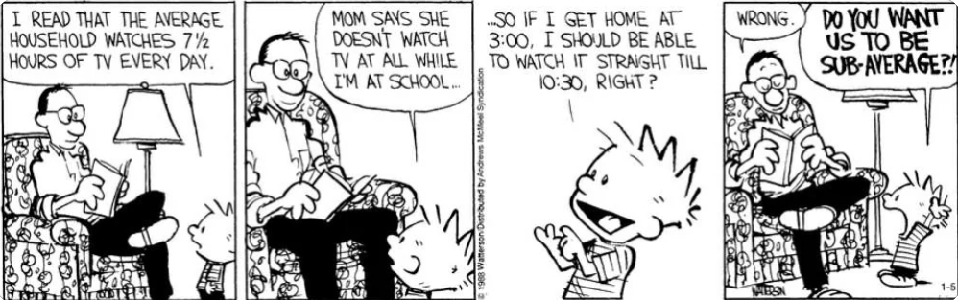
Use cases for (arithmetic) averages
  Everything else average arithmetically!
    Income Units Sold
    Factory Output Delivery Time
    Trade Volume Order Quantity
    Assembly Time Customer Acquisition Cost

Slide 11


Formula for averaging (arithmetically)
Population Mean
Sample Mean
$$\sum_{i=1}^{N}{xi}$$
$$\sum_{i=1}^{n}{xi}$$
μ =
X =
N
n
μ = population mean
x = variable being averaged
N = number of values being averaged
i = label for each value in the data
X
= sample mean (X-bar)
x = variable being averaged
n = number of values being averaged
i = label for each value in the data
Notes:
Sigma = Sum
Nothing to it…
Add up all the values (x₁, x₂, etc.) and divide by the count – N for the total population size, n for total sample size

Slide 12

Mmmm…mnemonic
To keep from confusing the symbols when calculating averages for populations (μ) and samples (x-bar), create a phrase with the easy to forget words - that’s easy to remember.
For example:
“For example”
example
x sample
: sample
Or:
“Greek Population”
Greek μ : population
X

Slide 13
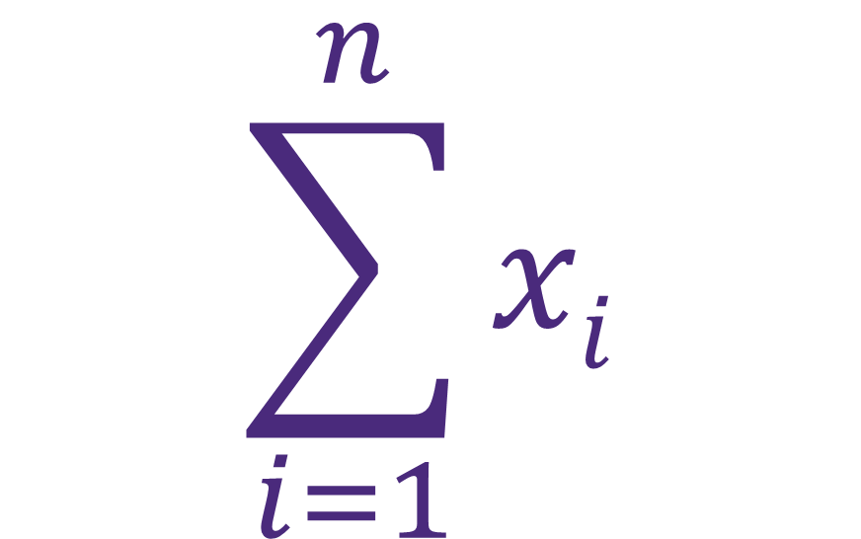

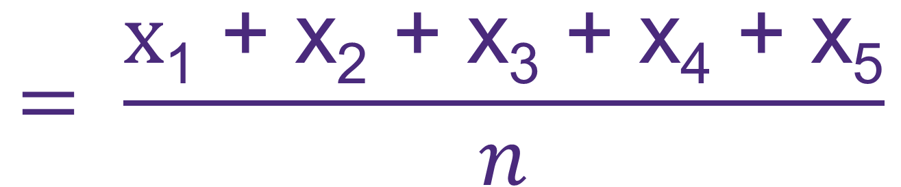
Formula for averaging (arithmetically)
Calculate the average daily balance for the 1st week of 2026
Date | 1/5/2026 | 1/6/2026 | 1/7/2026 | 1/8/2026 | 1/9/2026
Balance ($) | 144,529 | 148,337 | 150,041 | 140,645 | 142,890
x : Balance
i : Designates balance (1-5)
n : Count = 5
$$\sum_{i=1}^{n}{xi}$$
$$= \frac{\text{x}\text{1}\text{ + }\text{x}\text{2}\text{ + }\text{x}\text{3}\text{ + }\text{x}\text{4}\text{ + }\text{x}\text{5}}{n}$$
$$= \frac{ \text{144,529 + 148,337 + 150,041 + 140,645 + 142,890}}{5}$$
X =
n
$$=145,289$$
Notes:
This is a sample of five days, so the correct variables are little ‘n’ and x-bar

Slide 14
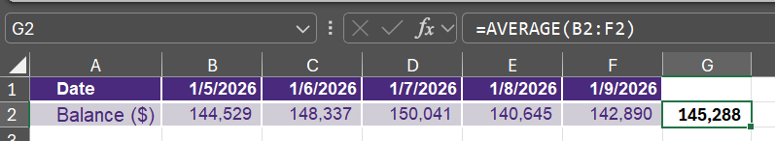
Averaging in excel
Calculate the average daily balance for the 1st week of 2026
Date | 1/5/2026 | 1/6/2026 | 1/7/2026 | 1/8/2026 | 1/9/2026
Balance ($) | 144,529 | 148,337 | 150,041 | 140,645 | 142,890
Use the ‘Average’ function in Excel:

Slide 15
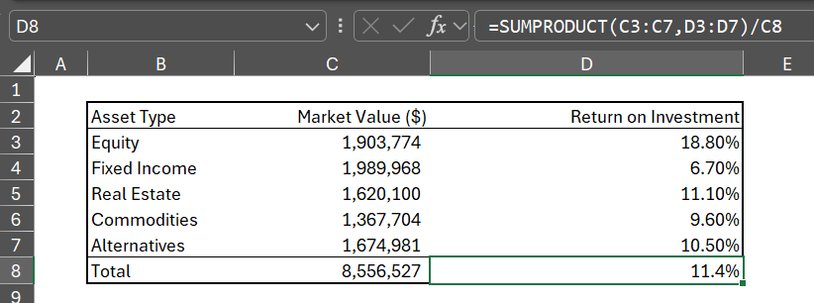
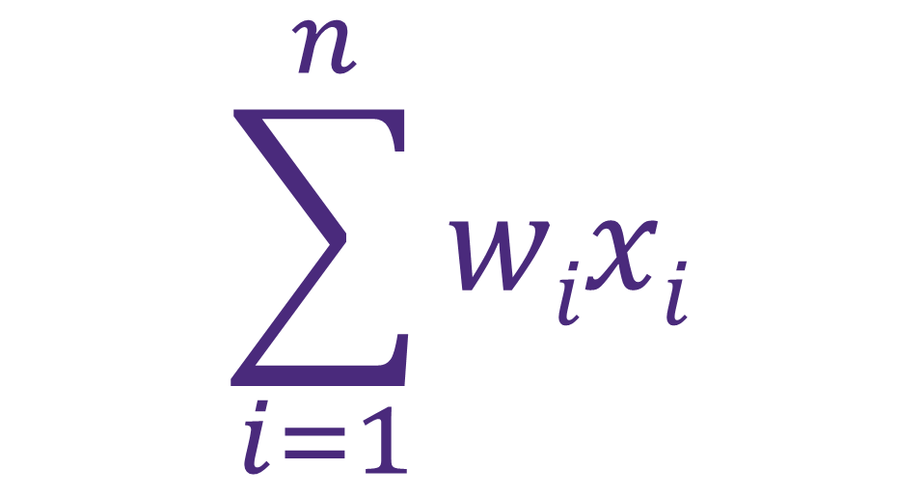
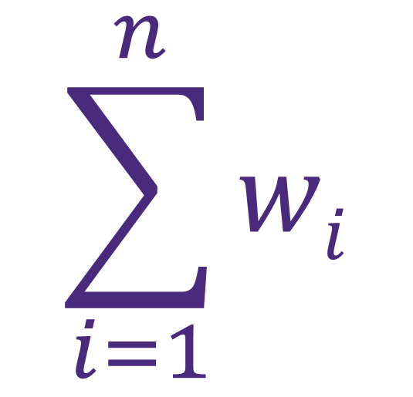
weighted average
Weighted Averages assign weights to each data point that correspond to their relative importance to calculate their average, rather than treating each value equally.
$$\sum_{i=1}^{n}{wixi}$$
X =
$$\sum_{i=1}^{n}{wi}$$

Slide 16
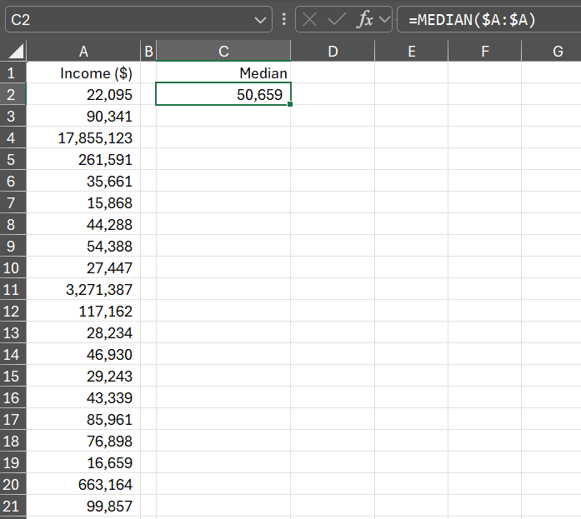
Median
The median is the midpoint of the data after it has been ordered from smallest to largest.
If there are an even number of values, average the two values in the middle to find the median.
Notes:
There are the same number of data points greater than the median as there are less than the median

Slide 17
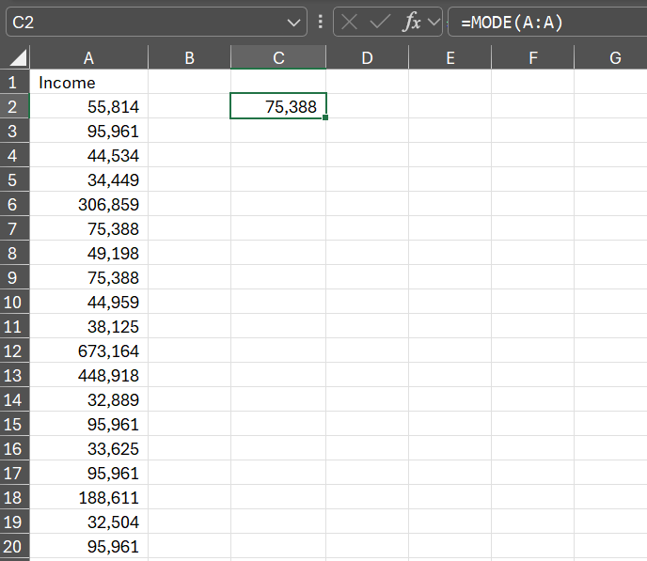
Mode
The mode is the value that appears most frequently in the data

Slide 18
Questions?

